Slide 1
GPS & IMU
Sanae Matsuki
EECE 5698 Robotic Sensing and Navigation
Homework 5, Spring 2017

Slide 2
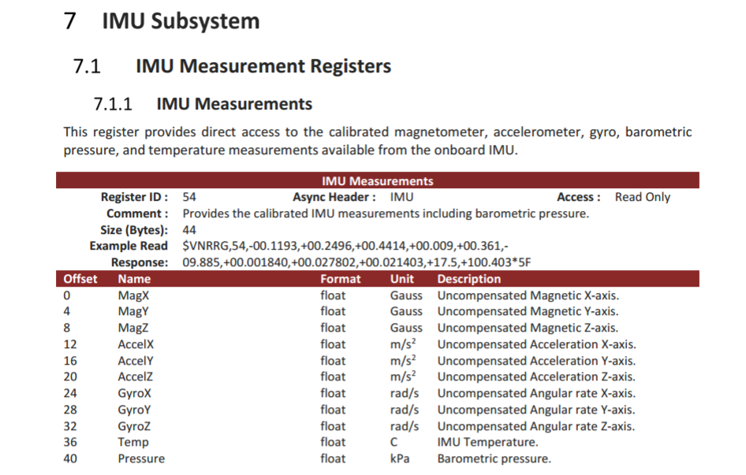
IMU Subsystem Measurements

Slide 3
Hard and Soft Iron Distortions
Distortions of the earth’s magnetic field are a result of external magnetic influence generally classified as either a hard or soft iron effect
Hard-iron: offset from (0,0)
Soft-iron: deform the circle to produce an ellipse
Distortion is dependent upon the distorting material rotating/moving with the sensor
Can be fixed computationally

Slide 4
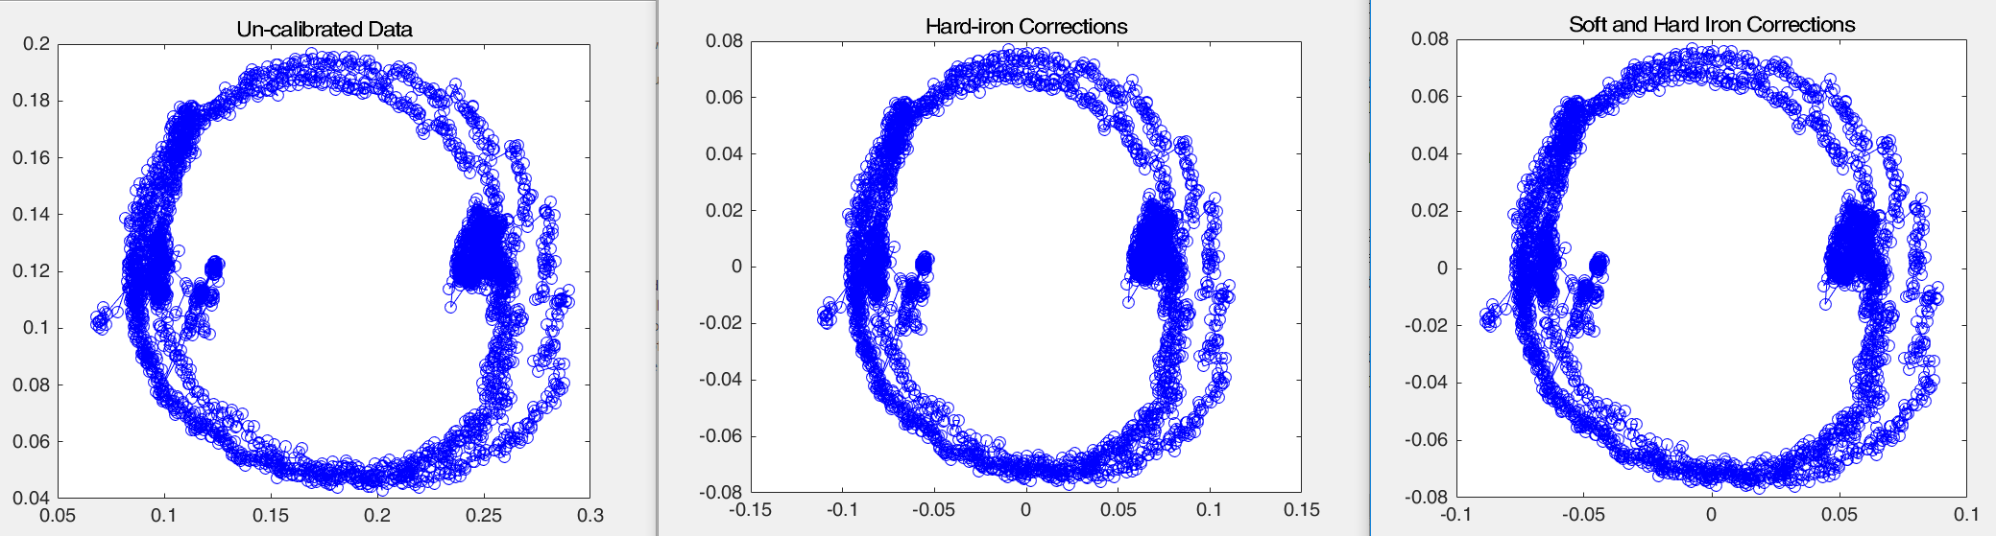
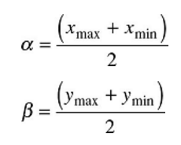
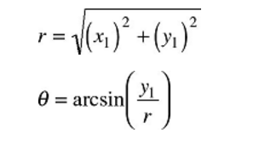
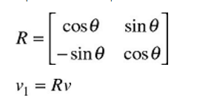
Hard and Soft Iron Distortion Fix

Slide 5
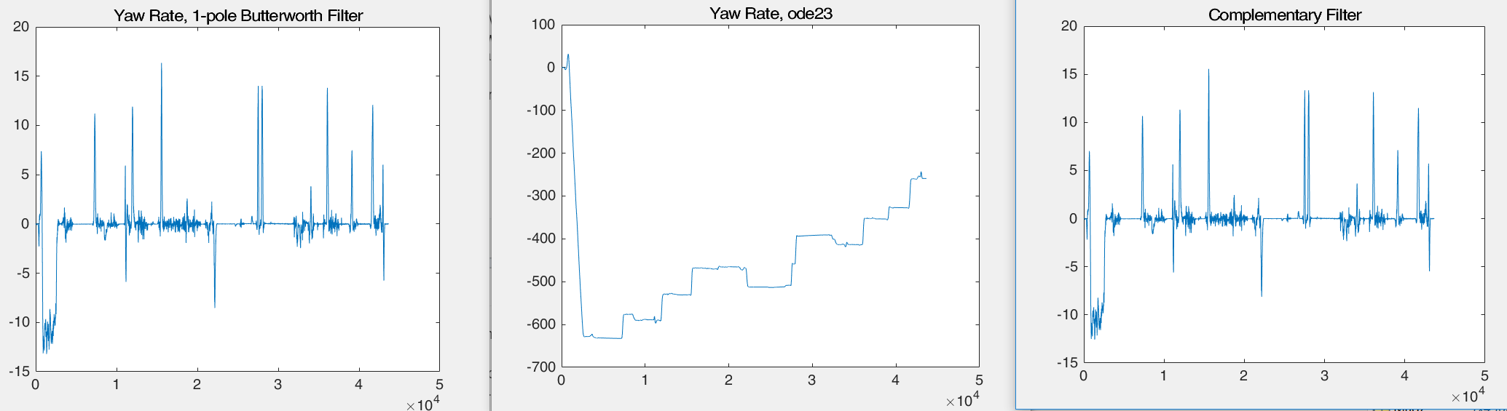
Yaw Rate

Slide 6
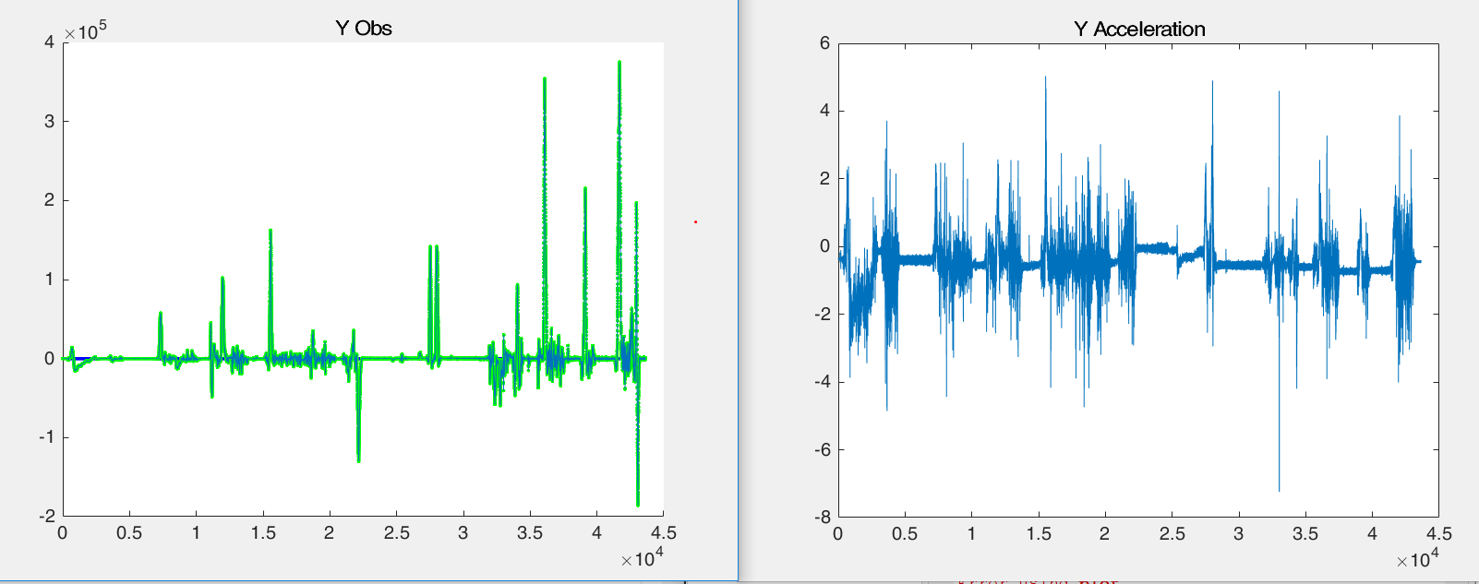
Comparing Y Acceleration and Y obs

Slide 7
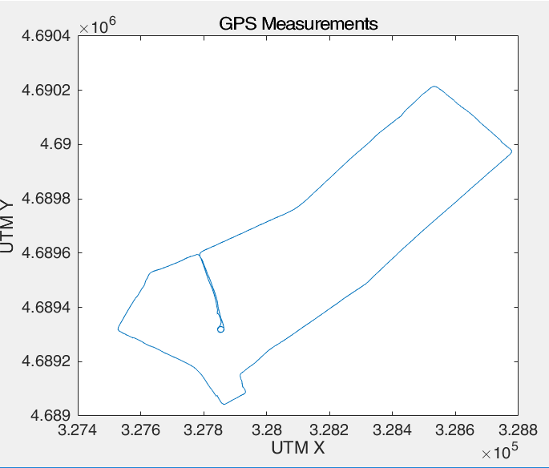
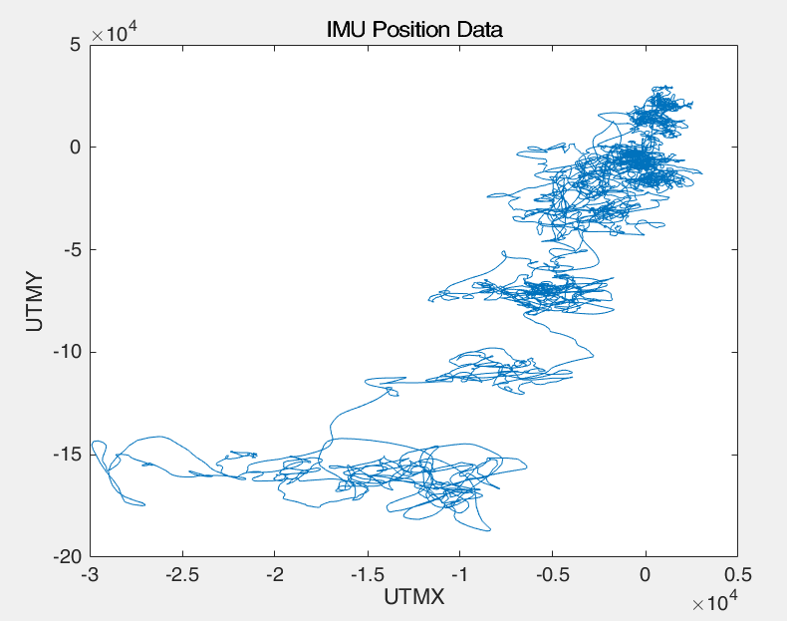
Position GPS vs IMU Sensor

